Slide 1
Name : Vinitha G
Reg No : 513121104047
College Name : Thanthai Periyar Government Institute of Technology
Department : Computer Science and Engineering
Year : Third Year
NM ID : au513121104047
Skill Build ID : vinithagovindaraj2004@gmail.com
Project Title : Indian Recipe generator using GPT2

Slide 2


Project title
Generating Indian Recipes using GPT-2
"Exploring Culinary Creativity with GPT-2"

Slide 3

Agenda
Problem Statement
Project Overview
End Users
Solution and its value proportion
The wow in my solution
Modelling
Conclusion

Slide 4
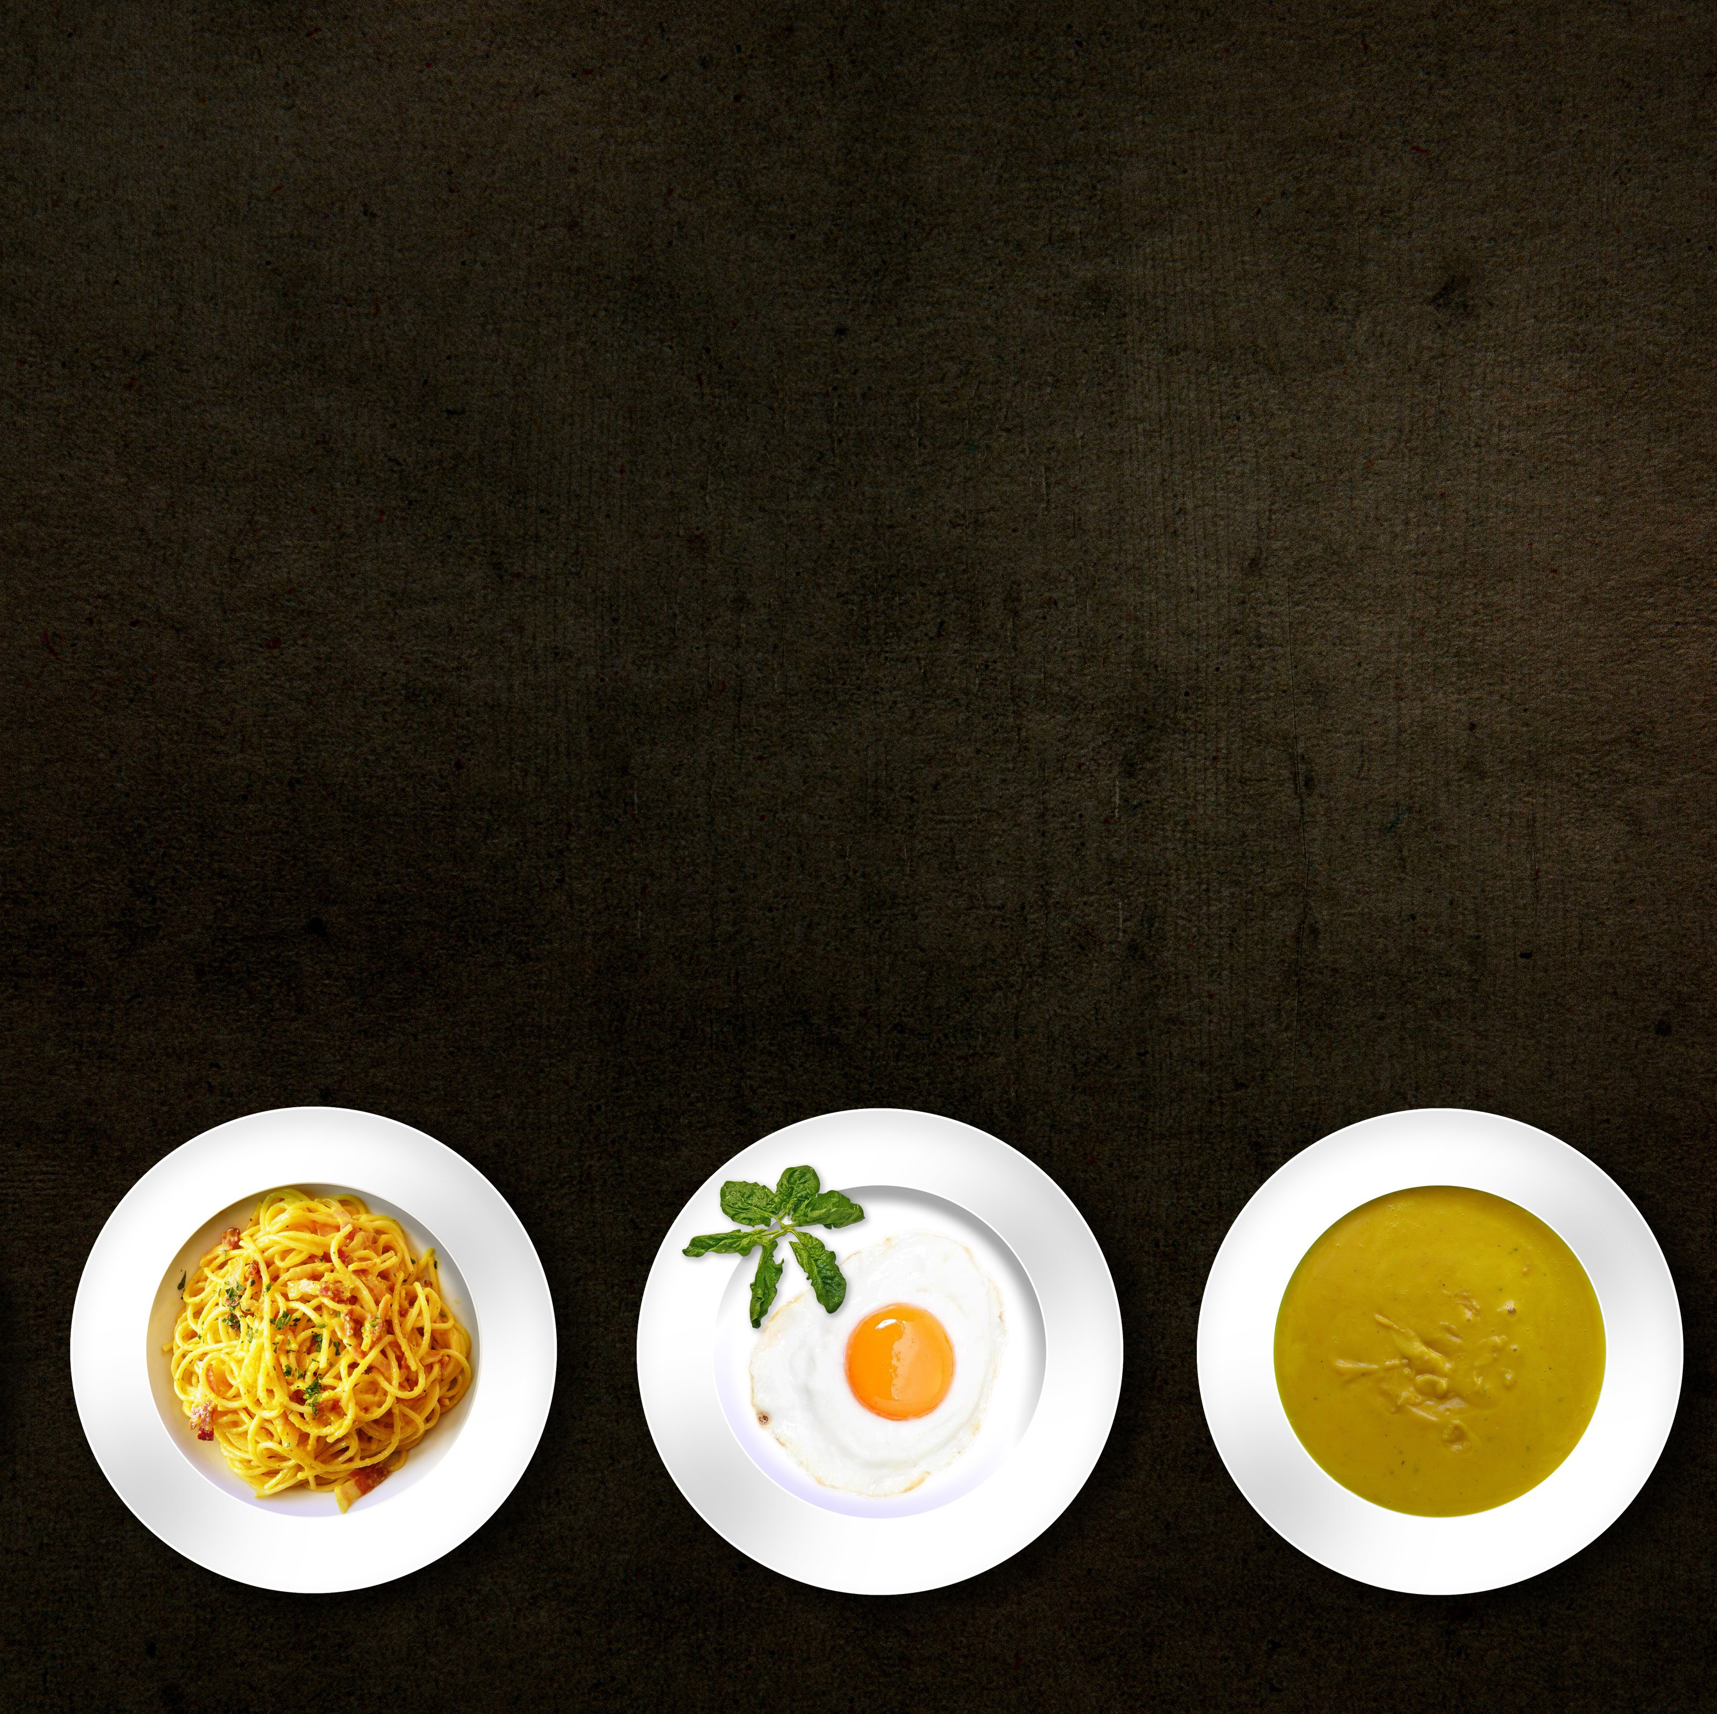
Problem statement
Develop an AI-powered system capable of generating authentic and diverse Indian recipes based on user input prompts.
The system utilize the GPT-2 language model to understand and interpret recipe requirements, incorporating a wide range of ingredients, cooking methods, and cultural nuances inherent to Indian cuisine.
The goal is to provide users with personalized and creative recipe suggestions that capture the essence of Indian culinary traditions while offering flexibility and adaptability to individual preferences and dietary restrictions.

Slide 5
Project overview
This project aims to leverage the capabilities of GPT-2, a powerful language model, to automatically generate Indian recipes. The objective is to explore how artificial intelligence can assist in culinary creativity and provide personalized recipe suggestions.
GPT-2: Developed by OpenAI, GPT-2 is a state-of-the-art language model capable of generating coherent and contextually relevant text based on input prompts.
Dataset: The project utilizes the Indian Food Dataset, which contains a diverse collection of Indian recipes, ingredients, and cooking instructions.

Slide 6

End users
Home Cooks and Food Enthusiasts: Individuals who enjoy cooking at home and are looking for inspiration and guidance in preparing Indian dishes.
Restaurants and Food Businesses: Chefs, restaurant owners, and culinary professionals seeking new recipe ideas or menu additions to diversify their offerings
Food Bloggers and Content Creators: Content creators specializing in food and cooking content who may use the generated recipes for their blogs, social media platforms, or cooking videos to engage their audience and provide valuable culinary content.

Slide 7
My solution and its value proportion
GPT-2 Architecture: GPT-2 consists of multiple layers of transformers, enabling it to understand and generate human-like text.
Text Generation Process: GPT-2 generates text by predicting the next word in a sequence based on the context provided by the input prompt.

Slide 8
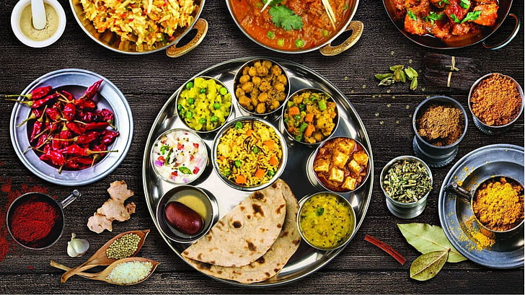
The wow in my solution
Cultural Authenticity: Our project specializes in generating authentic Indian recipes, capturing the diverse flavors and cooking traditions of Indian cuisine.
Creative Exploration: Leveraging the power of GPT-2, our platform encourages users to explore new flavors and cooking techniques, fostering culinary creativity and innovation.

Slide 9
Modelling
Data Collection
Gather diverse dataset of Indian recipes
Data Preprocessing
Clean and preprocess dataset
Tokenization
Formatting for model input
Model Training
Train GPT-2 model on recipe dataset
Fine-tune for recipe generation task
Recipe Generation
Utilize trained GPT-2 model
Generate recipes based on user input
Evaluation
Assess recipe quality (coherence, relevance, authenticity)
Solicit user feedback

Slide 10
Results
Example output :
Instructions: heat oil in a heavy bottomed pan. add onions and sauté till it turns translucent.add green chilies and sauté for 2 minutes. now add turmeric powder, red chilli powder, salt and mix everything well. add chicken pieces and mix well. cover the pan and cook until chicken is tender. serve hot.serve hot with a dollop of masala chai or any other chutney of your choice. serve hot with a dollop of masala chai or any other chutney of your choice. serve hot with a dollop of masala chai or any other chutney of your choice. you may also add some water and cook the chutney in low heat until tender. turn off the heat.serve hot with a dollop of masala chai or any other chutney of your choice. you may also add some water and cook the chutney in low heat until tender. turn off heat. serve hot with a dollop of masala chai or any other chutney of your choice. you may also add some water and cook the chutney in low heat until tender.turn off the heat. serve hot with a dollop of masala chai or any other chutney of your choice. you may also add some water and cook the chutney in low heat until tender. turn off the heat. you can optionally serve it as an appetizer for your parties. serve hot with a dollop of masala chai or any other chutney of your choice. you can optionally serve it as an appetizer for your parties. you can optionally serve it as an appetizer for your parties. you can optionally serve the chutneys as a snack or a dessert.
Example input :
chicken tomatoes aloo jeera curry powder red chilli powder onion cumin seeds (jeera) turmeric powder green chillies sunflower oil

Slide 11
conclusion
Summary: The project successfully demonstrates the potential of AI in generating Indian recipes, offering novel culinary inspirations to users.
Challenges: Addressing data quality issues and fine-tuning the model parameters were key challenges encountered during the project.
Future Directions: Future enhancements may include incorporating user feedback to improve recipe generation and exploring multilingual recipe generation for a broader audience.

